Slide 1
Git it Together:
Where Issues meet commits
@iamrlz

Slide 2
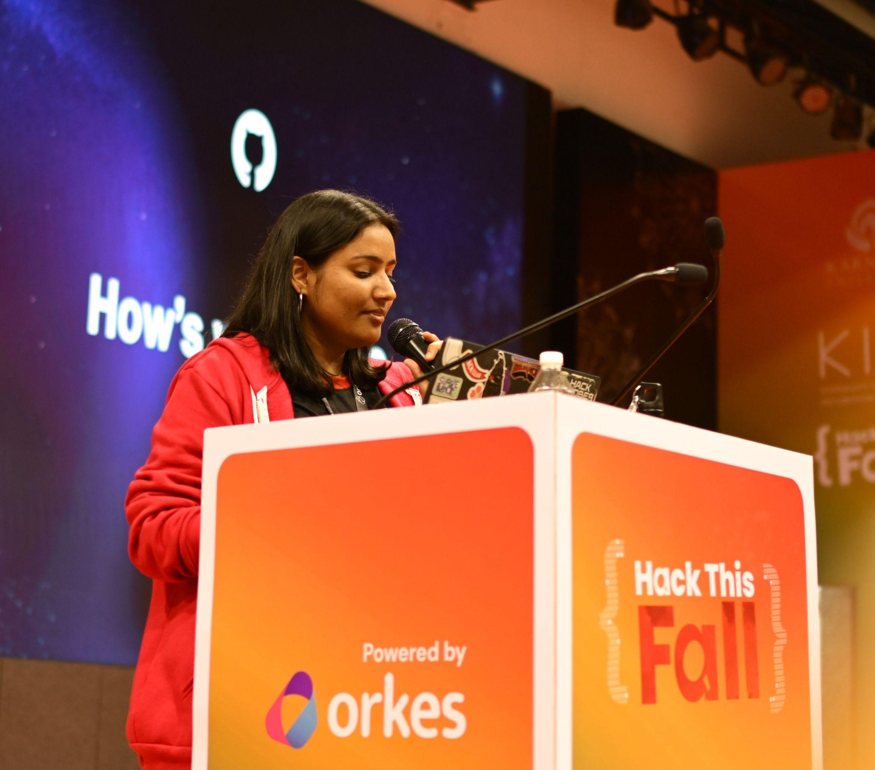
Me???
I’m Priyanshi
Community Enthusiast
UI/UX Designer
GDSC Lead’23
GitHub Campus Expert 🚩!
@priyanshi-rai
Notes:
Before we start!
I’m NAME and I’m a GitHub Campus from SCHOOL in CITY. I joined the program on DATE.
Add what you’re passionate about?
Add something about you outside of coding. (Hobby) Ex. When I’m not coding you can find me in making some awesome pottery or playing videogames with my friends
You can find me across the internet as USERNAME and feel free to reach out if you have any questions.

Slide 3
What are we gonna learn today?
GitHub for Students
Welcome to the Code Party!
GitHub: The Social Network for Code
Why GitHub Rocks!
Code Buzzwords: Speak Like a Pro
Your First Code Playground: Setting Up a Repo
Inside the Repo: A Guided Tour
Jump In: Getting Started with GitHub

Slide 4
GitHub is an online platform where developers store, share, and collaborate on code."
"Think of it as a social network, but instead of sharing photos or status updates, people share code!
What is GitHub?
Why is it Like a Social Network?
Notes:
The Campus Expert program is designed to support you by providing you with the best tools and resources to share your knowledge and learn new skills.
As a community leader you know the challenges students face on your campus. The program is designed to help you solve the struggles that you’re experiencing. We want to help you connect with other student communities to share ideas and best practices. The program will help you amplify your impact within your local community, attract more students to your events, and increase awareness of open source software .
By becoming a campus experts you get access to four main benefits from the program:
The Campus Experts training will give you community best practices, guidelines for using GitHub at your school, and advice for running events. Get advice from peers and mentors who will help you build confidence in public speaking, event planning, community outreach, and more!
Access GitHub conferences and speaking opportunities like GitHub Universe and Satellite
Receive exclusive swag and support from GitHub for your events.
Interact and collaborate with student community leaders beyond your campus.

Slide 5







What is Open Source?
• Open source software is code that is designed to be publicly accessible.
• Open source software fosters open exchange, collaborative participation, transparency, and community-oriented development.

Slide 6
Every time you make a change, GitHub saves it. You can go back and see what your project looked like at any point."
"It's like having unlimited undos and redos for your project."
Why GitHub ?
Version Control
Notes:
The Campus Expert program is designed to support you by providing you with the best tools and resources to share your knowledge and learn new skills.
As a community leader you know the challenges students face on your campus. The program is designed to help you solve the struggles that you’re experiencing. We want to help you connect with other student communities to share ideas and best practices. The program will help you amplify your impact within your local community, attract more students to your events, and increase awareness of open source software .
By becoming a campus experts you get access to four main benefits from the program:
The Campus Experts training will give you community best practices, guidelines for using GitHub at your school, and advice for running events. Get advice from peers and mentors who will help you build confidence in public speaking, event planning, community outreach, and more!
Access GitHub conferences and speaking opportunities like GitHub Universe and Satellite
Receive exclusive swag and support from GitHub for your events.
Interact and collaborate with student community leaders beyond your campus.

Slide 7
GitHub is home to millions of open source projects. You can contribute to projects that people all around the world use.
By exploring other people's code, you can learn new programming techniques and best practices.
Why GitHub ?
Open Source Community
Notes:
The Campus Expert program is designed to support you by providing you with the best tools and resources to share your knowledge and learn new skills.
As a community leader you know the challenges students face on your campus. The program is designed to help you solve the struggles that you’re experiencing. We want to help you connect with other student communities to share ideas and best practices. The program will help you amplify your impact within your local community, attract more students to your events, and increase awareness of open source software .
By becoming a campus experts you get access to four main benefits from the program:
The Campus Experts training will give you community best practices, guidelines for using GitHub at your school, and advice for running events. Get advice from peers and mentors who will help you build confidence in public speaking, event planning, community outreach, and more!
Access GitHub conferences and speaking opportunities like GitHub Universe and Satellite
Receive exclusive swag and support from GitHub for your events.
Interact and collaborate with student community leaders beyond your campus.

Slide 8




Benefits to students who want to explore and develop their coding skills
GitHub Pointers
Collaboration
Showcase Your Work
Learning and Growth
Community and Support
Notes:
The Campus Expert program is designed to support you by providing you with the best tools and resources to share your knowledge and learn new skills.
As a community leader you know the challenges students face on your campus. The program is designed to help you solve the struggles that you’re experiencing. We want to help you connect with other student communities to share ideas and best practices. The program will help you amplify your impact within your local community, attract more students to your events, and increase awareness of open source software .
By becoming a campus experts you get access to four main benefits from the program:
The Campus Experts training will give you community best practices, guidelines for using GitHub at your school, and advice for running events. Get advice from peers and mentors who will help you build confidence in public speaking, event planning, community outreach, and more!
Access GitHub conferences and speaking opportunities like GitHub Universe and Satellite
Receive exclusive swag and support from GitHub for your events.
Interact and collaborate with student community leaders beyond your campus.

Slide 9
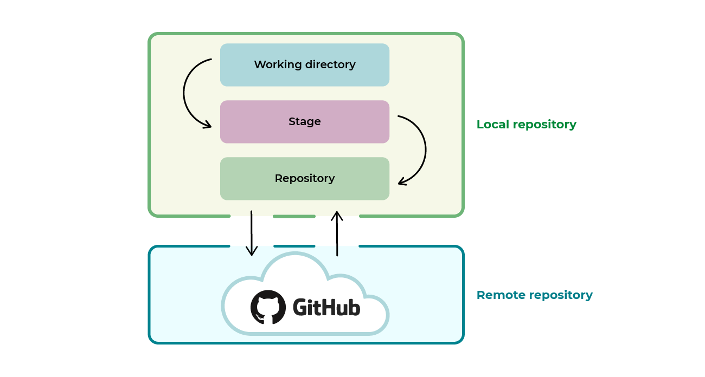
GitHub Slangs
Repository
A repository is like a bag(storage) that contain all the files and folders related to a project cloned in our system. The repository keeps a record of all the versions we had.
Notes:
The Campus Expert program is designed to support you by providing you with the best tools and resources to share your knowledge and learn new skills.
As a community leader you know the challenges students face on your campus. The program is designed to help you solve the struggles that you’re experiencing. We want to help you connect with other student communities to share ideas and best practices. The program will help you amplify your impact within your local community, attract more students to your events, and increase awareness of open source software .
By becoming a campus experts you get access to four main benefits from the program:
The Campus Experts training will give you community best practices, guidelines for using GitHub at your school, and advice for running events. Get advice from peers and mentors who will help you build confidence in public speaking, event planning, community outreach, and more!
Access GitHub conferences and speaking opportunities like GitHub Universe and Satellite
Receive exclusive swag and support from GitHub for your events.
Interact and collaborate with student community leaders beyond your campus.

Slide 10
LOCAL REPOSITORY
The local repository is present on our computer and consists of all the files and folders. This Repository is used to make changes locally, review history, and commit when offline.
REMOTE REPOSITORY
The remote repository refers to the server repository that may be present anywhere. This repository is used by all the team members to exchange the changes made.

Slide 11
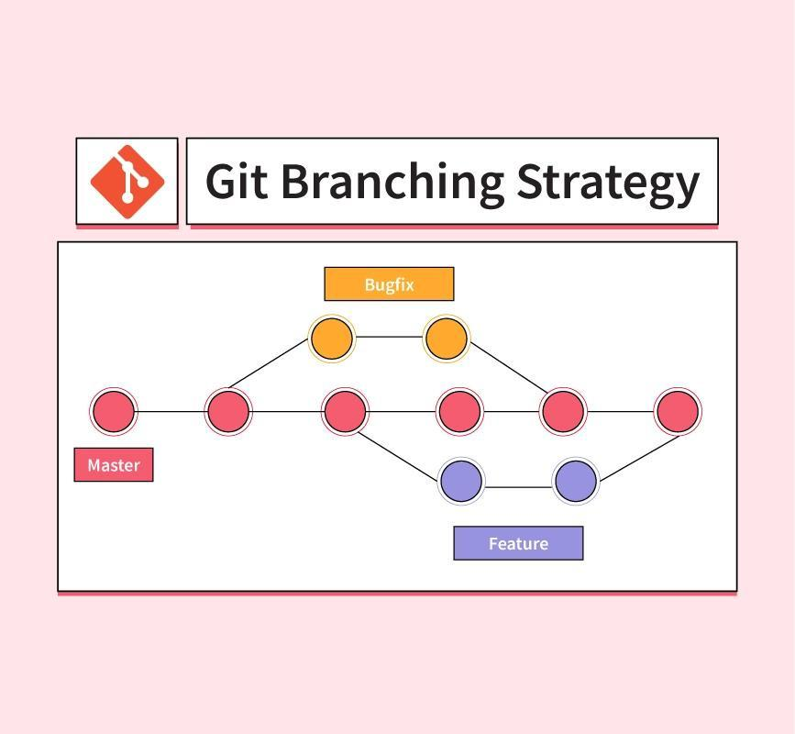
GitHub Slangs
Branching
Branching is like providing a separate room where one can create, update, and test your ideas without hindering the pre-existing project.
Notes:
The Campus Expert program is designed to support you by providing you with the best tools and resources to share your knowledge and learn new skills.
As a community leader you know the challenges students face on your campus. The program is designed to help you solve the struggles that you’re experiencing. We want to help you connect with other student communities to share ideas and best practices. The program will help you amplify your impact within your local community, attract more students to your events, and increase awareness of open source software .
By becoming a campus experts you get access to four main benefits from the program:
The Campus Experts training will give you community best practices, guidelines for using GitHub at your school, and advice for running events. Get advice from peers and mentors who will help you build confidence in public speaking, event planning, community outreach, and more!
Access GitHub conferences and speaking opportunities like GitHub Universe and Satellite
Receive exclusive swag and support from GitHub for your events.
Interact and collaborate with student community leaders beyond your campus.

Slide 12
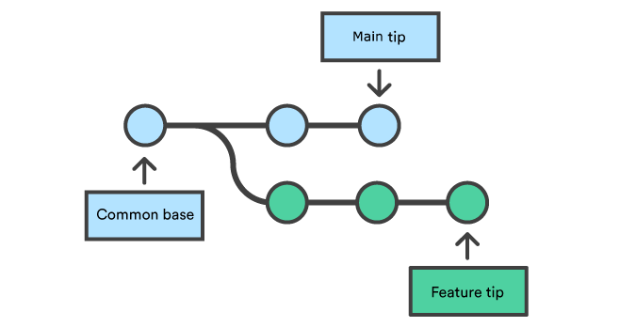
GitHub Slangs
Merging
Merging means integrating two or more branches. It is a process of combining different versions of codes(files).
Notes:
The Campus Expert program is designed to support you by providing you with the best tools and resources to share your knowledge and learn new skills.
As a community leader you know the challenges students face on your campus. The program is designed to help you solve the struggles that you’re experiencing. We want to help you connect with other student communities to share ideas and best practices. The program will help you amplify your impact within your local community, attract more students to your events, and increase awareness of open source software .
By becoming a campus experts you get access to four main benefits from the program:
The Campus Experts training will give you community best practices, guidelines for using GitHub at your school, and advice for running events. Get advice from peers and mentors who will help you build confidence in public speaking, event planning, community outreach, and more!
Access GitHub conferences and speaking opportunities like GitHub Universe and Satellite
Receive exclusive swag and support from GitHub for your events.
Interact and collaborate with student community leaders beyond your campus.

Slide 13
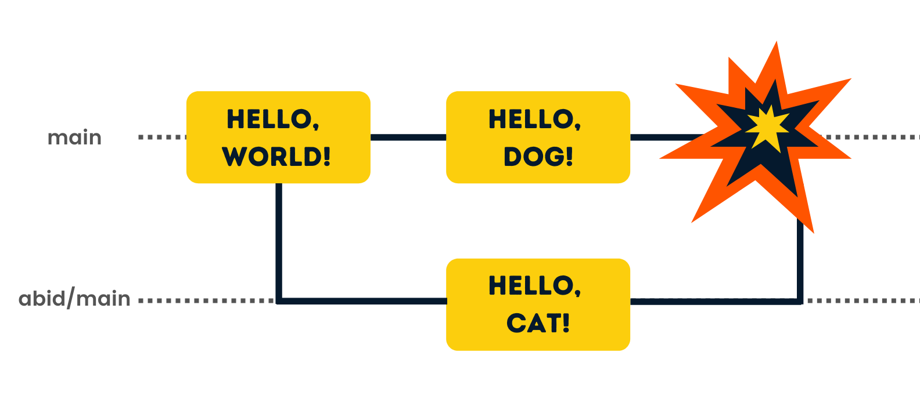
Merge Conflict
Suppose a file has the same question but different answers edited simultaneously in different branches(by user A and user B).

Slide 14

Commit
A saved change or snapshot of your project.
Like pressing "Save" in your document.

Slide 15
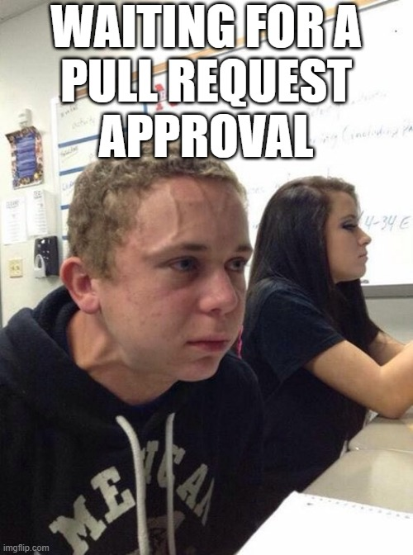
Pull Request
way to propose changes to the codebase.
Allows team members to review and discuss changes before integrating them.

Slide 16
Pull Request
way to propose changes to the codebase.
Allows team members to review and discuss changes before integrating them.

Slide 17


Slide 18
How you can apply for GitHub Student Developer Pack?
Notes:
Let’s talk about how you can be part of the program

Slide 19

Start with the GitHub Account
Application Process
1
Have a GitHub Account
2
Be at least 13 years old
3
Be currently enrolled in a degree from a recognized educational institution
4
Submit proof of your current student status through school documentation.
5
Submit your Application! Enjoy:)
Notes:
In order to become a campus expert the first thing that you need to have is the Students Developer Pack. The Pack has tens of tools and services that you can use to develop applications and learn with no cost –so it is always a nice-to-have.
The application process consists of two sections: first an application form and then a video resume. In the form, we’re looking for students to tell us about the challenges their student community faces, what opportunities they want to build for their peers, as well as the potential they see for growth. In the video resume, we’re hoping to get to know you better as a person, including your motivations and interests.
Applications to the program open twice a year—in February and August—and you’ll have a full month to submit. Once applications to the program close, the GitHub Education team will review it. This review period can take up to two weeks. If the team would like to move forward with you, they’ll reach out with instructions about how to submit your video resume. You will then have two weeks to do so.
A quick note on submitting your video: A video using your webcam and computer microphone is more than enough! We understand this process might not be accessible for all students. If you require an alternative method to make your submission, you can reach out to the GitHub Education team, and we’ll arrange some help. After your video has been submitted, we’ll take about a week to review it. If the program is the right fit for you, you’ll be accepted and receive an invitation to go through the GitHub Campus Experts Training.
There are four components we want to learn from you while applying to be part of the program:
Motivation: What makes you tick? What drives you?
Interest: Why do you want to be part of the program?
Growth and potential: What kind of skills do you want to learn, and how will they help you grow personally and professionally?
Contribution: What kind of an impact do you want to make on your campus?
If you’re application is successful you will get invited to a welcome call and start going through the Campus Experts training!

Slide 20
Ready to apply?
Notes:
Are you ready to apply? Applications are open now. Make sure you’re all set by getting the GitHub Student Developer Pack

Slide 21
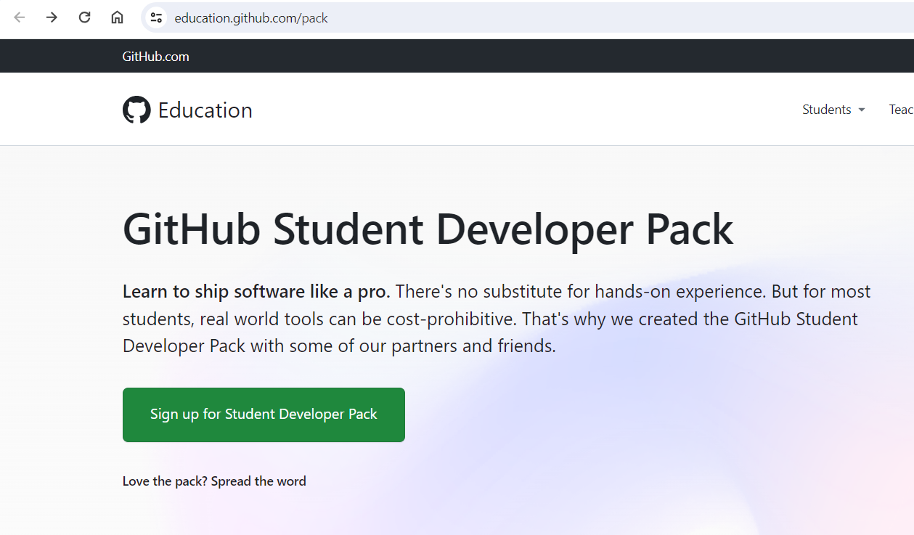

Slide 22
Ready for Bonus?

Slide 23

https://gh.io/lucknow24
Priyanshi-Rai

Slide 24
THANK YOU
FOR LISTENING!

